Slide 1
Citation Prediction
A classification model to predict traffic stop outcomes in Vermont

Slide 2
Project Outline
Data wrangling
Dropping null values
Primary feature engineering
EDA
Univariate (driver demographics, time data, stop details)
Targeted analysis (class distribution, multivariate eda)
Inferential Statistics
Independence tests
Bootstrapping techniques
Machine learning
Logistic regression + feature engineering
Gradient boosting classifier
Random forest classifier + feature engineering
Model optimization
Hyperparameter tuning (randomized search, grid search, feature engineering III)
Roc curve
Q: Can ticket stop outcome be predicted by features such as driver demographics, time data, or incident-specific details?

Slide 3
Introduction
The dataset contains traffic stop outcomes from 14 police departments in Vermont along with other relevant stop data such as demographics and incident specific information collected between the years 2010 and 2015.
The goal of this project is to use the features listed above to predict whether a traffic stop would result in a citation or a written warning.

Slide 4
Data Wrangling

Slide 5
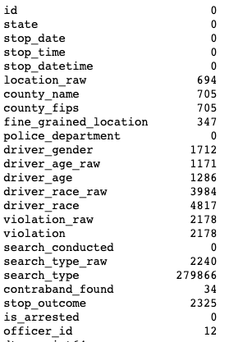
Handling nulls I
Dropped via pair-wise deletion:
'state', 'stop_datetime', 'county_fips', 'driver_age_raw', 'driver_race_raw', 'violation', 'search_conducted', 'search_type', 'is_arrested', 'officer_id', 'fine_grained_location', 'county_name', 'location_raw', 'id'

Slide 6
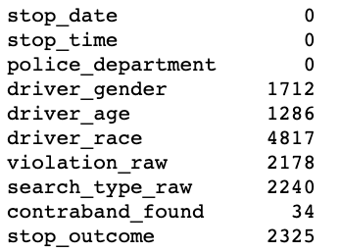
Handling nulls II
Dropped via list-wise deletion:
‘driver_gender’, ‘driver_age’, ‘driver_race’, ‘violation_raw’, ‘search_type_raw’, ‘contraband_found’, ‘stop_outcome”

Slide 7
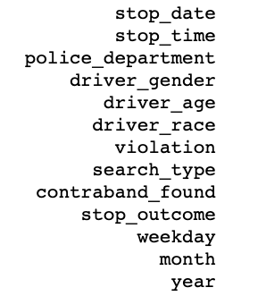
Primary feature engineering
weekday, month, and year columns are engineered from datetime column to gain more information
'stop_time' is condensed from HH:MM to just hour to reduce unneeded specificity

Slide 8
EDA

Slide 9
Univariate Analysis
univariate analysis is done by EDA to determine if variables should be further engineered or modified

Slide 10
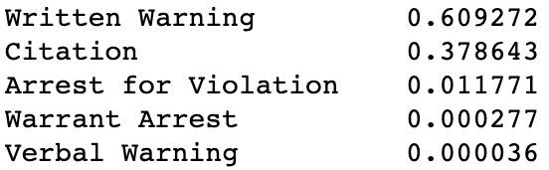
Target variable: stop outcome
A large class imbalance is seen here, so a decision is made to drop the rare classes and turn the classification into a binary problem.
I will keep only 'written warning' and 'citation' outcomes, as these are the most prevalent in the data

Slide 11
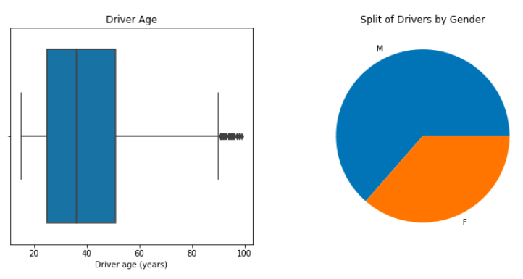
Driver demographics: age and gender
Driver age contained outliers above 90 years of age; these were deleted
Gender is somewhat balanced, and should be hot encoded for further analysis

Slide 12
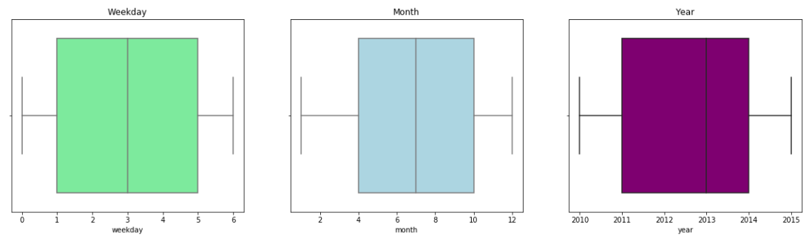
Time: weekday, month, year
Weekday, month, and year are all fairly evenly distributed
I added 1 to weekday to account for 0 indexing

Slide 13
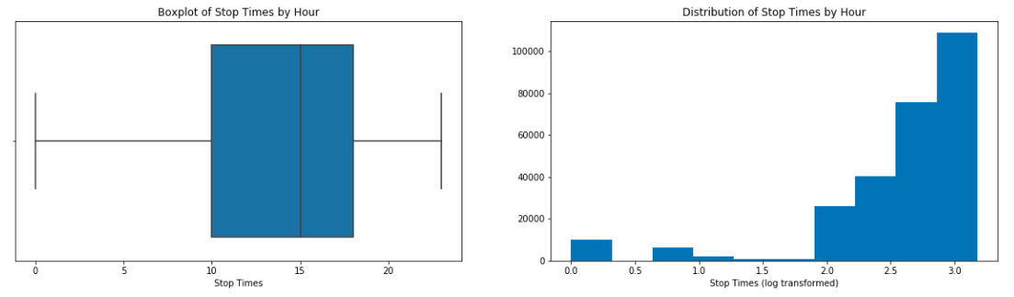
Time: stop time
stop time was log transformed to reduce skew, and an exponential distribution appears to emerge.
I added '1' to hour to account for 0 indexing

Slide 14
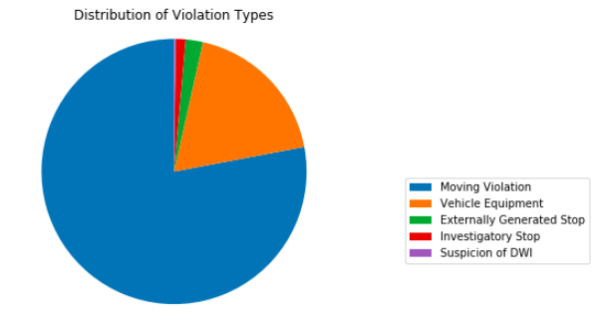
Details: Violation
Two outlier records were found and deleted from the violation column.
The violation column is dominated by moving violation, which is to be expected, as this is the most common form of routine police traffic stops.

Slide 15
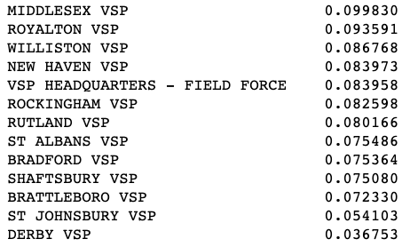
Details: police department
visualization
'VSP HQ- BCI/SIU/NIU' records were deleted due to it being an outlier (< 1%)

Slide 16

Details: search type
A ‘winooski’ variable was deleted for outlier reasons. The resulting distribution is shown above.
Since a majority of the data comes from “No search conducted”, this column was simplified to be binary (1 or 0) for no search conducted, or unspecified search conducted.

Slide 17
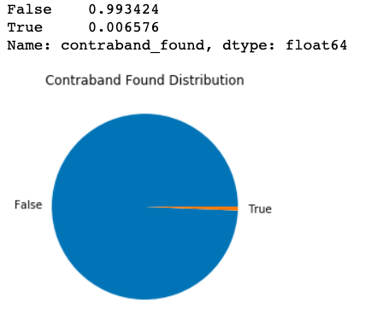
Details: contraband found
As a majority of the stops did not find contraband, this feature was dropped.

Slide 18
Bivariate analysis
Stop outcome is evaluated in consideration with driver demographics, time data, and traffic stop variables.
Features are compared with the target variable

Slide 19
Male vs Female

Slide 20
Stop outcome variation with driver demographics

Slide 21
1
Stop outcome data is plotted for male and female groups.
The same data is plotted along a yearly axis to see if the trend is consistent year after year.

Slide 22
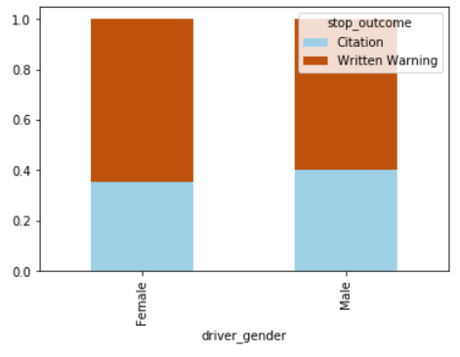
Both genders receive written warnings more often, but females receive written warning slightly more often than males on average.

Slide 23
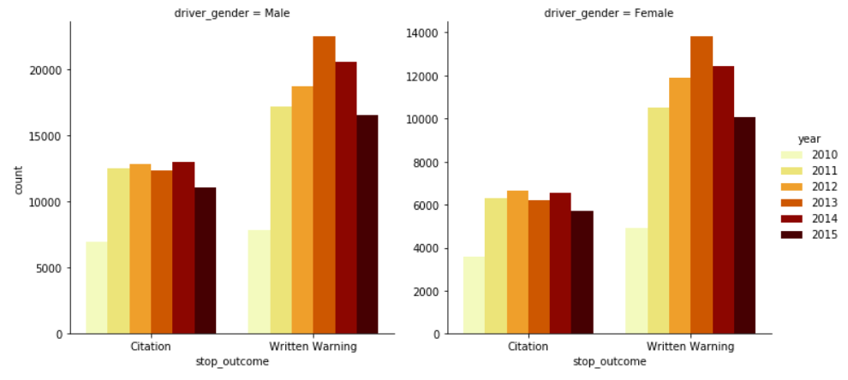

Slide 24
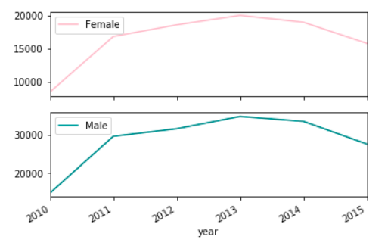
** shown to visualize the differing amounts of data present for males and females across the years

Slide 25
The amount of citations received seems to stay consistent across years in both males and females.
The written warnings increase heavily after 2010, and spike in 2013. However, as shown in the line graph above, this is probably due to the differing amounts of data available for each year. (2013 had the most data, with 2010 having the least)
While comparing citation:written warning ratios within female and male groups, it appears that the ratio is higher in males than in females.

Slide 26
2
Stop outcome data is compared among driver race groups.
The same data is plotted after being grouped by police department to spot any inconsistencies or possible racial bias among differing stations.

Slide 27
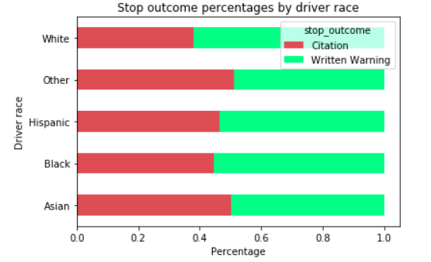
From this graph alone, we can see that whites are the least likely to receive a citation when compared amongst other races. However, the skew in data must be acknowledged, as most of the data belongs to the white class.

Slide 28
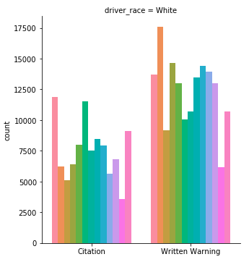
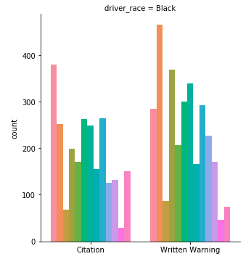
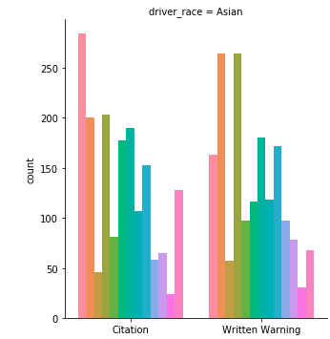
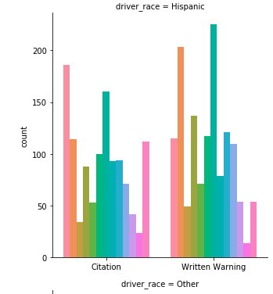
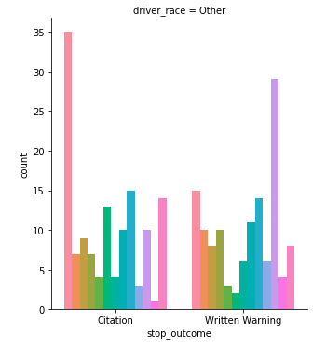
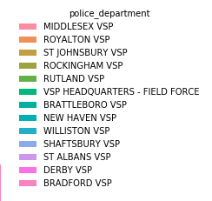

Slide 29
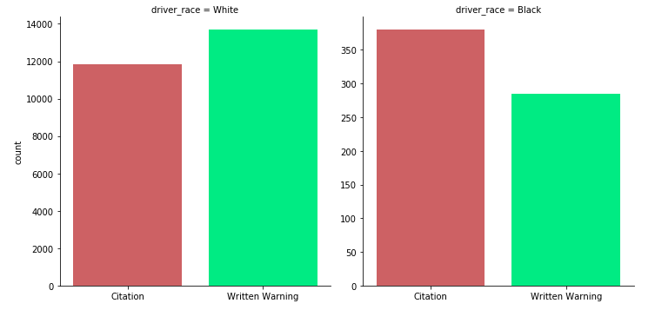
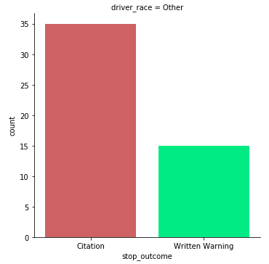
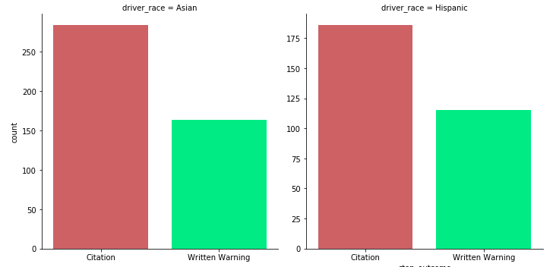
**Middlesex VSP police department data only

Slide 30
Middlesex vsp police department stands out here, as there appears to be more citations than written warnings in every race category except white in this group.
After further investigation of this police department, the potential bias in handing out more written warnings to white people is maintained.

Slide 31
3
Age is split into 3 groups: early drivers (high risk, 0-25), middle aged drivers (lowest risk, 25-50), older drivers (medium risk, 50+).
Stop outcome trends are then compared among age groups.

Slide 32
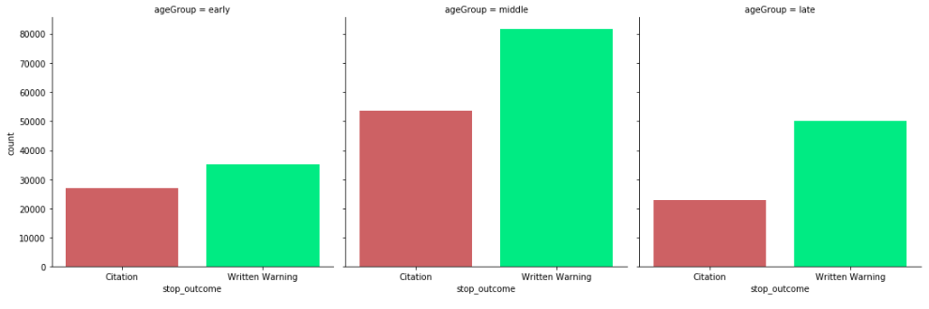
All three age groups get more written warnings than citations, but early drivers have a lower written warning : citation ratio, indicating they receive slightly more citations than other age groups.

Slide 33
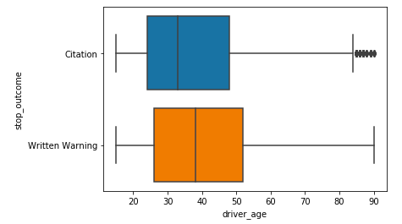
The boxplot of original age data confirms this idea: older drivers get more written warnings on average than younger drivers.
Additionally, it seems to be very rare for a driver in the 'late' age group category to receive a citation.

Slide 34
Stop outcome variation with time data

Slide 35
1
Stop outcome data is compared with hourly data to see if there is a notable difference in outcome depending on the time of day.

Slide 36
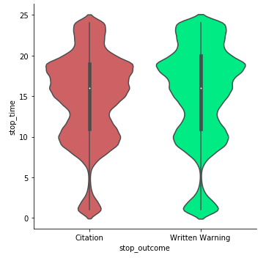
From this graph we can see that most traffic stops occur after noon and before 8pm. In this region of high activity, we see more citations than written warnings.
However, in the early morning and late evening, the trend reverses and we see more written warnings than citations.

Slide 37
2
Stop outcome data is compared across weekday to uncover any patterns that may occur on a day to day basis.

Slide 38
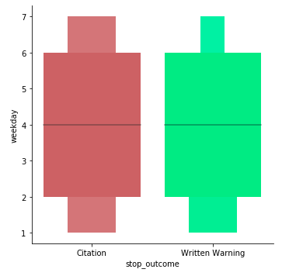
As expected, most of the traffic stops occur in the weekdays; this makes sense as people travel more often during the week than during the weekend.
On Saturdays, more citations are given out than written warnings, whereas the rest of the week is distributed equally.

Slide 39
3
Stop outcome data is compared across months to determine if stop outcome distributions are the same each month

Slide 40
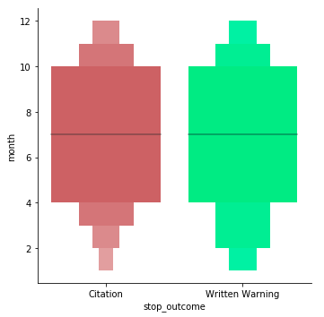
Here we see that most of the data comes from April-October.
- In early months, more written warnings are given out than citations.
- Mid year we see an equal distribution of citations and written warnings
- Late year sees a decrease in overall data, but the split between citations and written warnings remains about equal

Slide 41
4
Stop outcome data is compared year to year to find out if trends have changed annually or stayed generally the same.

Slide 42
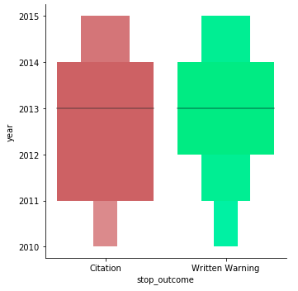
Annual data is distributed equally except in 2011, where we see more citations than written warnings.

Slide 43
Stop outcome variation with traffic stop variables

Slide 44
1
Stop outcome data is compared with violation type to understand how the two variables relate to one another.

Slide 45
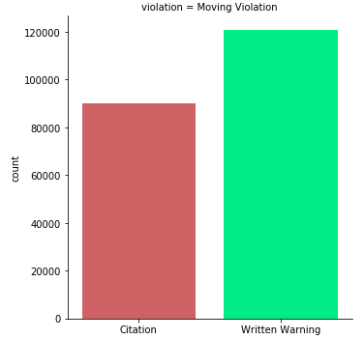
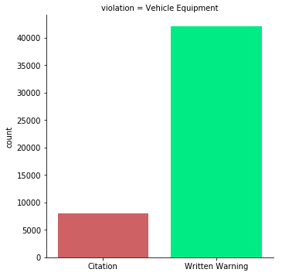
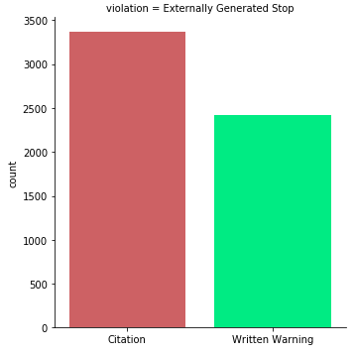

Slide 46
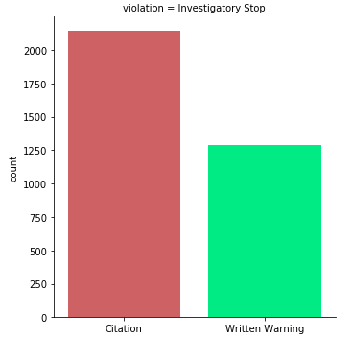
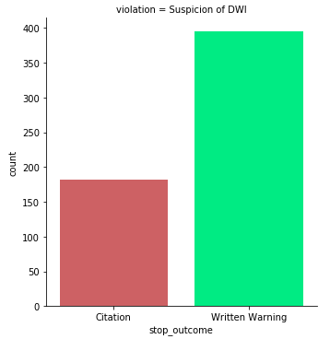
In each of these categories except two, written warnings are more numerous than citations. However, in 'investigatory stop' and 'externally generated stop', more citations were observed than written warnings.

Slide 47
2
Stop outcome data is compared with search type to understand how the two variables vary with one another.

Slide 48
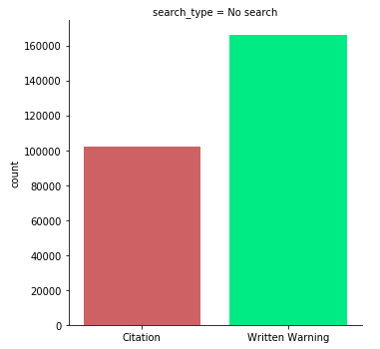
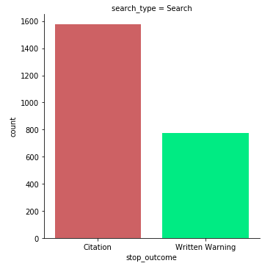
We see a much higher rate of citations when a search was conducted, which is to be expected since the officer must have reasonable conviction to search.

Slide 49
Inferential Statistics

Slide 50
Chi squared tests of independence

Slide 51
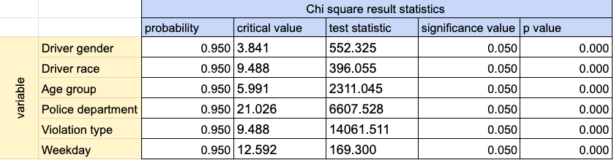
Each variable seen on the right was compared with the target variable, stop outcome, to test whether or not the two were independent of each other.
In each case, the null hypothesis was that the two variables had no relationship, and in each case I was able to reject the null hypothesis.

Slide 52
Bootstrap hypothesis testing

Slide 53
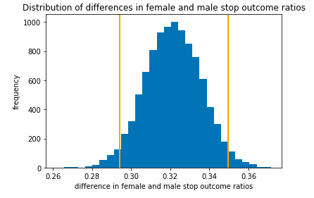
Ho: The ratios of female and male stop outcomes (written warnings:citations) are the same
Ha: The ratios of female and male stop outcomes are different.
Reject null hypothesis

Slide 54
Machine Learning

Slide 55
Baseline Test (default parameters)
Terrible performance in the minority class

Slide 56
Feature Engineering I
In an effort to improve the logistic regression model, I created a correlation matrix with the features to see if I could drop any highly correlated columns to reduce dimensionality.
93 features were dropped (mostly dummy variables)

Slide 57
Logistic Regression (reduced dimensionality)
Improvement in precision
Recall still suffers
Continue to use reduced dataset

Slide 58
Baseline Random Forest Classifier
Accuracy suffers

Slide 59
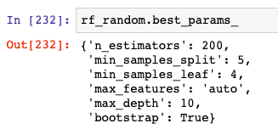
Hyperparameter tuning I
Randomized search
100 iterations with a 3 fold cross validation loop

Slide 60

Random Forest Classifier: randomized search
Better accuracy
Worse recall, f-1 score

Slide 61
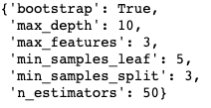
Hyperparameter tuning II
Grid search best parameters found

Slide 62

Random forest Classifier: grid search
Improvement in precision

Slide 63
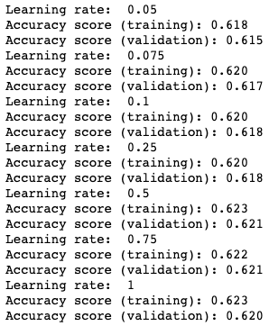
Gradient Boosting Classifier: hyperparameter tuning
Data scaled prior
Learning rate of 0.5 chosen

Slide 64

Gradient Boosting Classifier
Recall and f-1 score still poor

Slide 65
Feature Engineering II
I am rerunning the best performing model, random forest, without dummy variables.
To do this, I created a new dataframe with all the categorical variables back intack. I then used a label encoder to convert all of the categorical columns into integers.

Slide 66

Random Forest Classifier: best model
Best performing model with a good accuracy rate,and decent values for important metrics across the board.

Slide 67
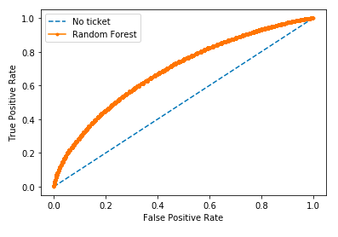
ROC AUC=0.690

Slide 68
Conclusions

Slide 69
Results summary
While I originally thought the best idea was to convert the categorical features to dummy variables, I found this caused the models to overfit the data.
After reducing the dataset by many of these dummy variables, I found that the best idea was actually to revert back to the original dataframe and use a label encoder to deal with the categoricals.
After hyperparameter tuning, reduction of my target variable to two classes, and proper encoding of my categoricals, I was able to improve modeling by almost 10%
Recall and precision improved the most through feature engineering, which was important because of the large class imbalance.

Slide 70
Future Directions
Further modelling and hyperparameter tuning should be done such as running a gridsearch or random search with the final random forest classifier model.
Additional data on the minority class (citation receivers) could improve the accuracy of the model

